Slide 1


Public Image & Public Relations RLI - Part 3
Notes:
Begin the session:
Introduce self
Describe format for the session
Talk about what materials are available and/or where they can be found

Slide 2
Goals:
Identify
Identify my club’s target audience and how we can effectively reach it
Explore
Explore how my club can benefit from a Public Relations Strategy
Discuss
Discuss appropriate communications tools used in promoting Rotary activities.
Investigate
Investigate RI resources available to Rotarians for public relations undertakings
Notes:
Review Session Goals, where this course fits into the Leadership curriculum of RLI
Quickly review Insert: PIPR-1 “Good to Know Public Relations and Public Image Resources”

Slide 3

Breakout Partners
“Describe for me a public relations effort in which your club engaged for one of its projects, successful or not”.
Notes:
Present the situation on the screen.
Divide group into pairs or trios.
Open-ended questions are a technique used to elicit information and dig deep into a particular subject. With your partner, one will ask the question and the other will LISTEN and ask follow-up questions as needed.
If you don’t think you can remember it once you are in your breakout snap a picture of it with you cell phone or do a screenshot
Launch breakouts and give them 2 minutes for the activity
Bring group back and take one or two examples.
Debrief activity by sharing:

Slide 4

Who Is Your Target Audience?
Notes:
Use the question as a conversation starter
Who is the (your) club’s target audience?
It is expected that the difference between target audience types will engender an attempt to categorize internal and external audiences
A club’s target audience depends on what the club is doing and what it wants to accomplish
Using the ANNOTATION TOOLS have participants offer responses on the slide.
Briefly discuss all the different target audiences.
Clarify that for the purposes of this session how to appeal to different target audiences in particular external audiences will be explored.

Slide 5
What’s the Difference?
Public Image
Public Relations
Publicity
Notes:
Ask participants to respond to these terms, one at a time, with a word or phrase that comes to mind.
What word or words come to mind when I say PUBLIC IMAGE? Raise VIRTUAL HAND and unmute to offer your thoughts. How about PUBLIC RELATIONS? What about PUBLICITY?
Acknowledge responses as they come in and share with the group
Lead a brief discussion addressing the differences the subtle distinctions among them using some or all the following points:
There are many definitions of and distinctions made between these terms
MacMillian Dictionary defines these terms as:
Publicity – the activity of creating a good opinion among people about a person, product, company or institution or information that makes people notice a person, product, company or institution
Public Relations – the relationship between an organization and the public
Public Image – the concept that the ideas and opinions that the public may have about a person or an organization may not be what they really are
In which do Rotarians have more control?

Slide 6


Communication Tools…
Internal
External
Notes:
Introduce communication tools as part of effective PR effort:
Communication is key in successful Public Relations/Publicity and ultimately Public Image initiatives. Communications can be internal and/or external and in most cases should probably include both. What tools are available for each? Using the ANNOTATION TOOLS, we’ll collect the tools with which you are familiar, and your Rotary club has used to communicate to your target audiences on the blank slide.

Slide 7
Internal
External
Notes:
Collect “tool” responses on the BLANK SLIDE.
Comment on whether folks believe the tools are INTERNAL or EXTERNAL.
Tools offered should include but not be limited to:
Newspaper, Internet (many options)’ TV, Radio, Billboards, Club Brochures, Fundraisers, Feature Article, Branding of Event or Project
Weave into the discussion topics that include:
Who is the target audience for internal communication?
Who is the target audience for external communication?
How does your club handle internal and external communications?
Why is PR/PI as important to a small club as it is to a large club?

Slide 8
Breakout – Case Study
Specific PI/PR Idea
Method of Communication
Type of Media Used
Basic Message
Do the questions apply?
Notes:
Refer to INSERT PIPR-2: Public Relations Case Study
Divide participants into two(2) groups: Internal (members) and External (public) target audience
We will be forming two (2) breakout groups – Internal and External. Examine the case study from your group’s perspective and record specific PI/PR ideas that will reach your group. Include the following for each idea (refer to screen):
Specific PI/PR idea
Method of Communication
Type of media used
Essence of the message
Whether and how any of the four case study questions apply to or expand your group’s ideas.
Choose a spokesperson to share your results with the whole group.
Each group will examine the case study and record specific Public Relations ideas and methods of communication for their audience
This should include specific types of media to be used and the use of each method
Groups should address any of the four case study questions that relate to their audience
Debrief – reconvene whole group and hear from each about their thoughts regarding the case study.

Slide 9
Building Rotary’s Public Image
E-learning - Course Catalogs - Rotary Learning Center
Notes:
INTERACTIVE WEB STUDY – E-learning on Rotary Learning Center
Introduce resources available to Rotarians from Rotary International
Direct participants to open up another browser window on their device and sign into My Rotary.
Have them scroll down and find the link for “Visit the Learning Center” and click on it. This opens Course Catalogs – Rotary Learning Center.
Scroll to the right on the second row to access “Building Rotary’s Public Image”

Slide 10

Collaboration with District Public Relations
Notes:
Ask the question:
How does your district communicate district events and district projects?
How does your club interface with that communication?
Use these questions to open the door to the need to communicate to club members about what the club is doing and how the club might benefit from what the district is doing

Slide 11

Rotary Brand Center https://brandcenter.rotary.org/en-GB
Notes:
While showing this slide, point out how to get to Brand Center.
Have participants open another browser window and find the Rotary Brand Center.
Show slide 11

Slide 12
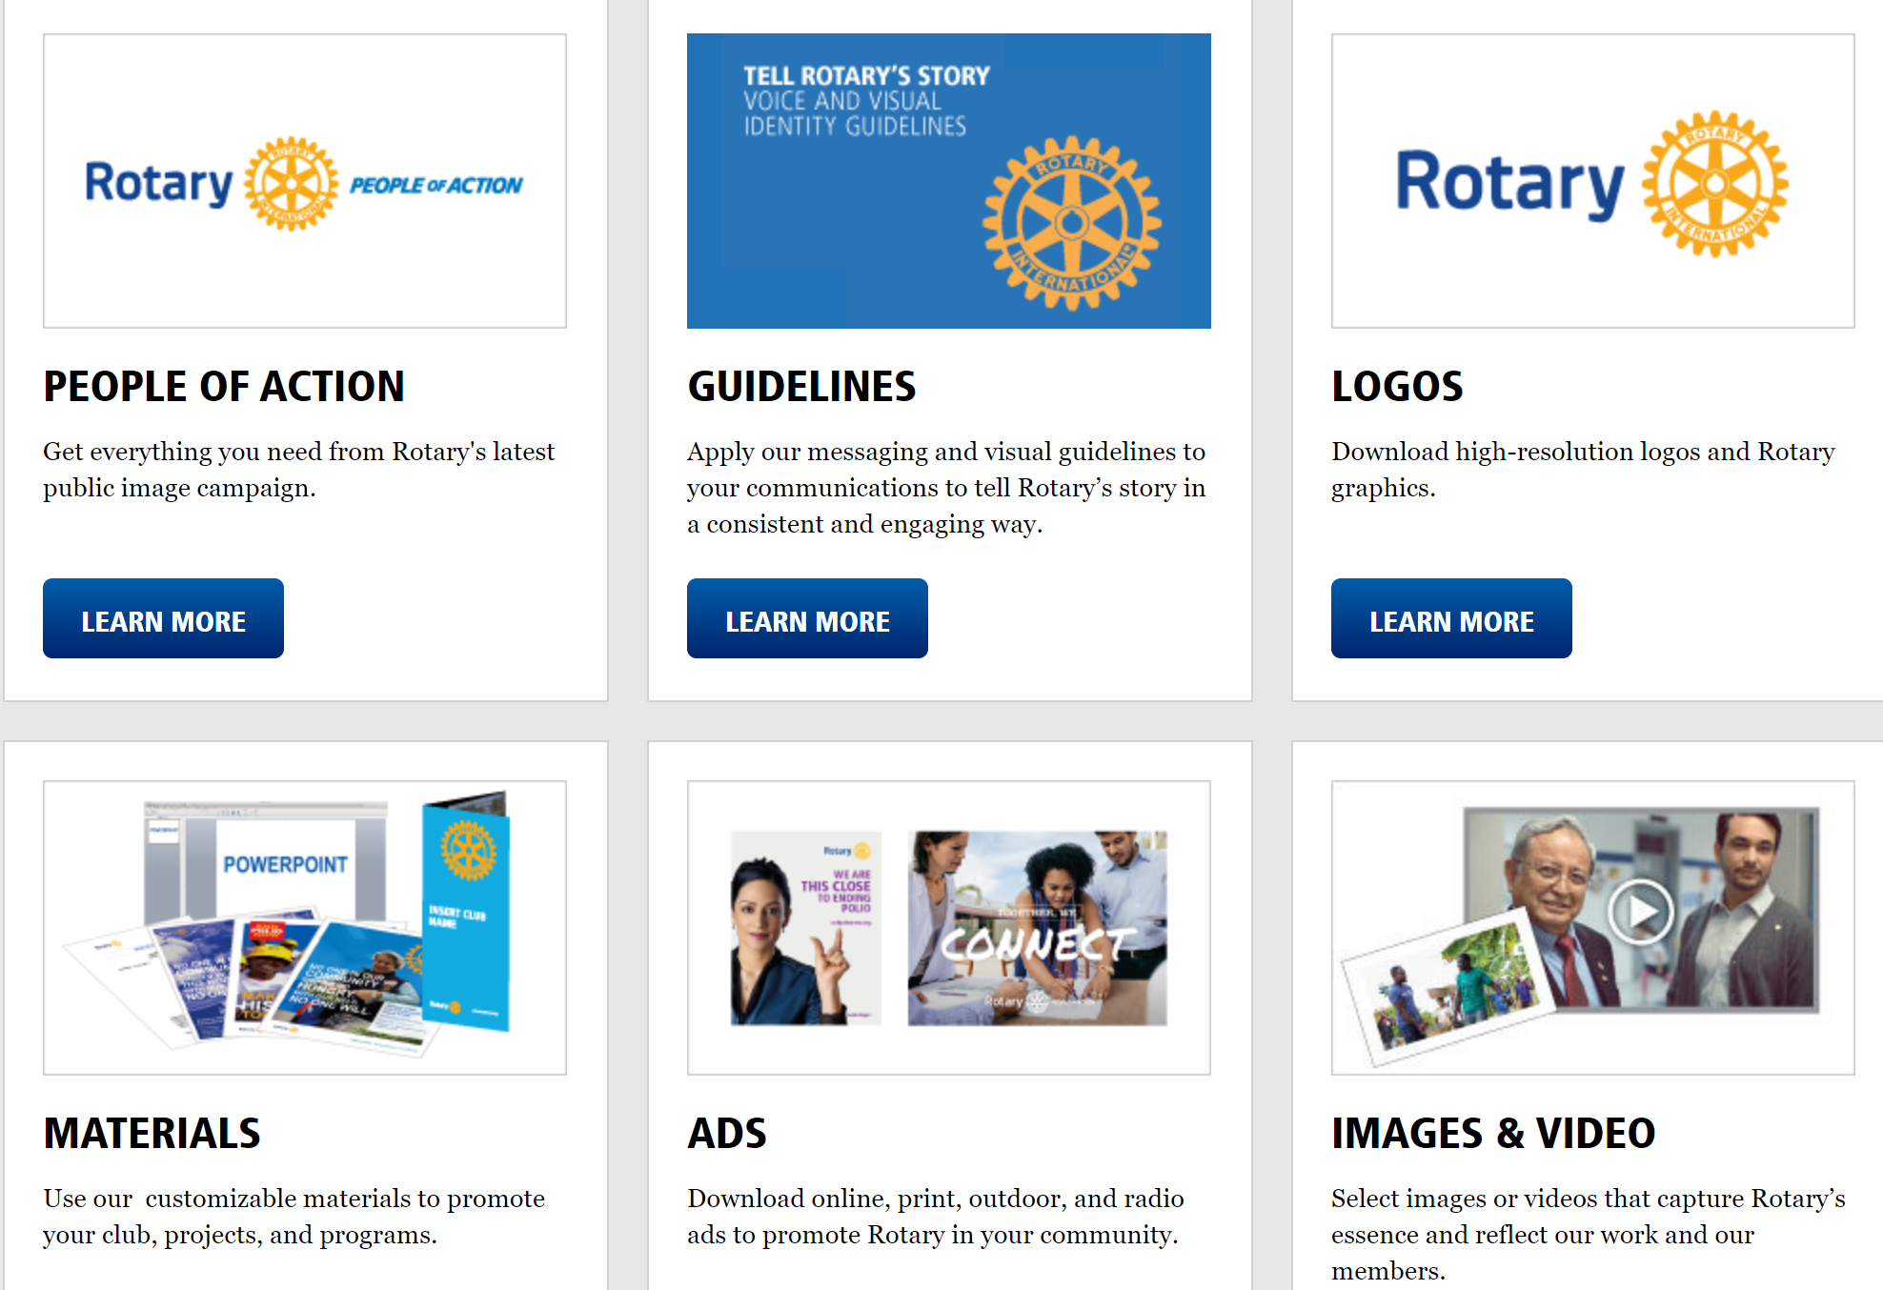
What’s at Brand Center?
Notes:
Point out the:
Guidelines
Materials
Ads
“Learn More” buttons that provide resources for clubs to use in helping to promote projects and events.
Allow participants time to navigate the site as time allows and/or encourage them to revisit the site and use for their projects.

Slide 13
Reflection
What can you do today to improve the PR/PI/PUBLICITY of your Rotary club’s main community project or activity?
What would a single communication of that idea look like?
Notes:
Reflect on the session/topic:
Think about – What can you do today to improve the PR/PI/PUB of your Rotary club’s main community project or activity?
What would a single communication of that idea look like?
Review by pointing out:
PI/PR/PUB is an important, but often overlooked, aspect of club projects and activities
Reaching others, inside and outside a club, is key to the club’s success and effectiveness
You can be a key contributor in the PR/PI/PUB effort in your club, and can encourage planning, effective strategies and consistent messaging in your projects and activities.
It is more likely to be good if the club has a PR strategy and makes the members part of it.
Who is the target audience? Use the PR/PI/PUB analysis, determine what it is and is it effective to reach the target audience? Is this the right “tool” for the job or would another be more effective”
Stress commonalities and keep things positive

